Slide 1

Object Detection
Mikołaj Leszczuk, Jakub Nawała
Notes:
Detect - to notice something that is partly hidden or not clear, or to discover something, especially using a special method (from Cambridge Dictionary)
One wants to say if and where the object is. However, we are not at all or not so much interested in identifying a particular object. For example, I just care that what I see is a pedestrian, but I do not care that this is the same pedestrian I saw previously and his name is Patrick. That would be Object Recognition. In general, Object Recognition and Object Detection are strongly related, but they are not the same.

Slide 2
Object Detection
A Computer Vision technology
One of the most important tasks for:
Image Processing
Image Recognition
Determining object position and identifying it
Based on that, for example:
Determining object features (like a colour)
Counting objects
Detecting more detailed features
Object Tracking
Notes:
Computer vision - deals with how computers can be made to gain high-level understanding from digital images or videos.
Identification is necessary only if we want to detect many objects. In this context, identifying means to be able to say whether something is a person or a chair. We are, in general, not able to say that this person is Mark or that this is Mark’s chair.
Regarding determining object features - well, a part of the (machine-learning based) Object Detection (OD) pipeline is to find features of the object. We thus already have some features ready after the detection.

Slide 3
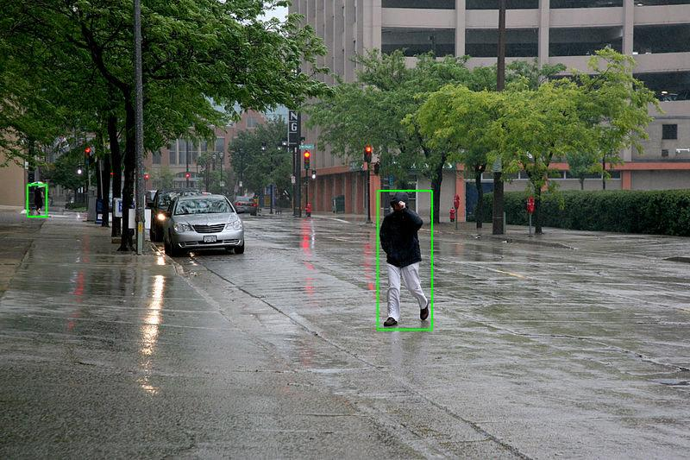
Object Detection
Broad spectrum of applications, like:
Self-driving cars
Vehicle/pedestrian traffic monitoring
Medical imaging
Security systems
Surveillance systems
Image taken from Wikimedia Commons, for author and licensing see here
Notes:
Self-driving car must be able to detect and understand road signs.

Slide 4
Concept
Object classes having their own distinguishing features, e.g.:
All circles are expected to be round
All squares are expected to be rectangular
Object class detection using special features, e.g. looking for:
Circles: seeking for objects at particular distance from centre
Squares: seeking for objects:
Perpendicular at corners
Having equal side lengths
Similar approach used for face identification where finding:
Eyes
Nose
Lips
Skin colour features
Distance between eyes

Slide 5
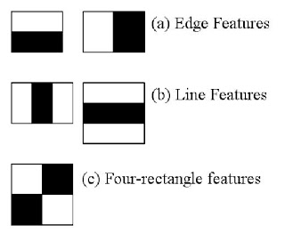
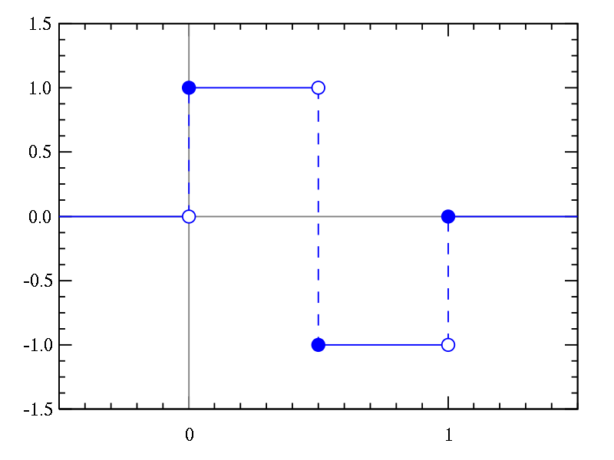
Concept
Object classes have distinguishing features
Those are used to identify a class of an object
Our faces also have such features
e.g. Haar-like features
Viola-Jones object detection
Upper image taken from this OpenCV tutorial. Lower image taken from Wikimedia Commons and licensed under the CC-BY-SA-3.0 license. Here is the link to the original image.
Notes:
Haar-like because they resemble Haar wavelets. However, there is no formal relationship.
We calculate a sum of pixels lying below the white and black area, separately. Then, we calculate a difference between those. This result is a single feature. Now, this operation is repeated for many locations and sizes of Haar-like features. All this happens in a search window. If you are given an image, you start with some arbitrary window and then slide it through the image. If nothing was found, you change the size of the window and repeat the procedure.
This is computationally intensive, so some clever ideas were needed to do this in real-time. Viola and Jones did it in 2001.

Slide 6
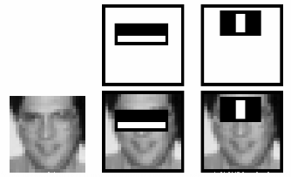
Concept
Not all features are needed
Most areas in the image are not a face
cascaded classifier
Haar-like features useful for objects other than faces
More info here
Image taken from this OpenCV tutorial, which took it from the “Rapid object detection using a boosted cascade of simple features” paper of P. Viola and M. Jones, DOI: 10.1109/CVPR.2001.990517.
Notes:
There are 160 000+ Haar-like features (i.e. 1, 2, 3 and 4-rectangle features) in 24x24 pixels window. We train the classifier to filter-out redundant features.
Cascading - check weak classifiers in a sequence of stages. If the first stage fails, do not go further.
We, meaning human being, proposed features so this is a machine learning approach. A deep learning approach is another method. It will be shown soon.

Slide 7
Pixel-Based Techniques & Algorithms (1/2)
Advantage – image made of pixels
In most cases knowing location of points (pixels)
Starting point of most of techniques & algorithms:
Take image
Convert it to grayscale
Detect edges
Move along edges

Slide 8
Pixel-Based Techniques & Algorithms (2/2)
Circles
Squares
Draw normal (intersecting at center)
Do this for entire circle or find connected edges
Calculate Euclidean distance between center and connected points
Check if edges to be straight lines or not (check if pixels having either same x or y coordinates)
Look for 90 degree change in angle (if moving along horizontal line then, at the corner, the y coordinate will stop changing and x will start changing)
Notes:
Explanation what normal is

Slide 9
Object Detection Models
Deep learning object detection
Feature-based object detection
Viola-Jones object detection (feature based)
Support Vector Machine (SVM) classification with Histograms of Oriented Gradients (HOG) features
Image segmentation & blob analysis
Other methods for detecting objects with Computer Vision using:
Gradient-based approaches
Derivative-based approaches
Template matching approaches

Slide 10
Approaches
Machine learning
Deep learning
You define the features
You choose a classifier
Some training data needed
No significant computing power required
No need to define the features
Requires a huge amount of training data
Requires a huge amount of computing power
Notes:
Machine learning:
Actually, you decide how to extract the features, but it can be handled by a feature extractor
It can achieve accurate results with minimal data
Many traps
Bad features - bad accuracy
Deep learning:
Deep learning offers a high level of accuracy but requires a large amount of data to make accurate predictions
This is why big players (like Google) have an advantage over small players
You need approx. 1 000 representative images for each class you want to detect
“Representative” here is very important (fisheye distortions, x-ray vs. visible light)
You can ask the training algorithm to artificially generate more training data (rotation, scaling, warping etc.)
You can use a pre-trained neural network
Sometimes, even a couple of dozens of representative images for each class will suffice
But those must be similar to the data originally used to train the network
This is a state-of-the-art solution
YOLOv3 runs 30 FPS on NVIDIA Titan X Pascal (a graphic card for approx. 5 000 PLN) - compare this with 15 FPS in 2001 with the Viola-Jones algorithm
1 GFLOP of Intel Pentium III (Viola-Jones) vs. 343 GFLOPs of NVIDIA Titan X Pascal (YOLO)
Image size is not an important factor: YOLO accepts images being of resolution up to 416x416 px (most probably similar to what Viola-Jones can efficiently operate on)
The increase is in accuracy and a number of classes we can detect
Training data means labelled data - someone had to manually look at an image and decide - is there an object or not?.
Mathworks’ tutorial comparing machine learning with deep learning for object recognition.
How many images do you need to train a neural network?

Slide 11

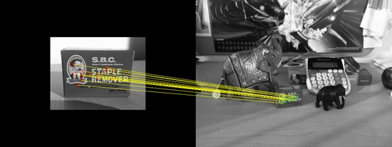
Examples
Feature-Based Object Detection
Detecting a reference object (left) in a cluttered scene (right)
Using feature extraction and feature matching
RANSAC (Random sample consensus) used to estimate location of object in test image*
Machine learning
Image taken from this MathWorks’ tutorial on Object Detection
Notes:
RANSAC - Random Sample Consensus, is an iterative method for estimating a mathematical model from a data set that contains outliers. The RANSAC algorithm works by identifying the outliers in a data set and estimating the desired model using data that does not contain outliers.
IMPORTANT distinction:
Feature detection - finding points which are somehow “special”
Feature extraction - computing a descriptor from pixels surrounding the “special” point

Slide 12
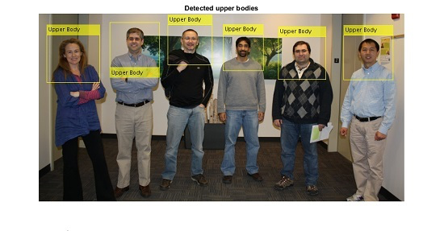
Examples
Feature-Based Object Detection
The first real-time face detection using Viola-Jones Object Detector
The Upper body detection also using Viola-Jones Object Detector
Machine learning
Image taken from this MathWorks’ tutorial on Object Detection
Notes:
This first real-time face detection (15 FPS) ran on Intel’s Pentium III having 500 MHz clock frequency (1 GFLOP vs. 343 GFLOPs of NVIDIA Titan X Pascal).
Viola-Jones pipeline used for detecting something else than just faces

Slide 13
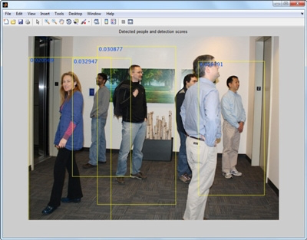
Examples
SVM
Classification
with HOG Features
Human detection
Using pre-trained SVM (Support Vector Machine) with HOG (Histogram of Oriented Gradients) features
Machine learning
Image taken from this MathWorks’ tutorial on Object Detection
Notes:
HOG - Histogram of Oriented Gradients, feature extractor
SVM - Support Vector Machine, a classifier, after a training, it can differentiate between a given set of classes (for detection of which it was trained) - using a set of features extracted from an image

Slide 14
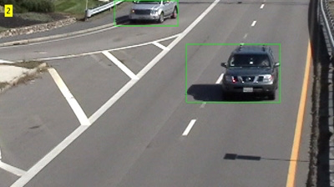

Examples
Image Segmentation
& Blob Analysis
Machine learning
Moving cars detected using blob analysis
Image segmented using background subtraction; moving pixels detected from video frame shown in white
Images taken from this MathWorks’ tutorial on Object Detection
Notes:
Image segmentation - partitioning an image into segments, each including pixels having similar characteristics. Black circles on a white background all belong to a single segment. However, each of them is a different blob.
Blob Analysis - analysis of consistent image regions; white objects on a black background are consistent and each such an object is a blob.
It can, but does not have to use machine learning.
TODO: Add “References” slide

Slide 15
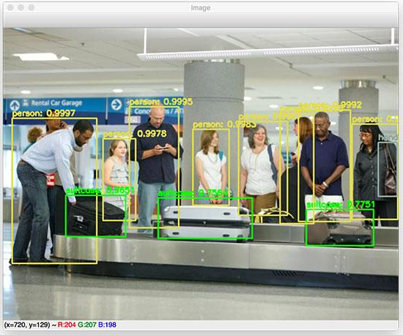
Examples
Regions proposals (R-CNN, Fast R-CNN & Faster R-CNN)
Single Shot Multi Box Detector (SSD)
You Only Look Once (YOLO)
Deep learning
Information and image taken from this article at pyimagesearch.com
Notes:
Regions proposals:
It required a non-NN algorithm for region proposals in the first two versions (R-CNN and Fast R-CNN)
At first, those were painfully slow, and we are talking about the year 2012!
Faster versions shown in 2015
Faster meaning 5 FPS when run on a GPU
A two-stage detector
Good accuracy
SSD and YOLO
A single-stage detector
Less accurate, but much faster
Up to 150 FPS on a powerful GPU
YOLO was first shown in 2015
It is not very precise, but can classify many classes
The latest update appeared in 2018

Slide 16

A Video Showcasing YOLO

Slide 17
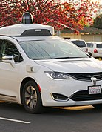
Ground Truth for Self-Driving Cars
Driverless vehicles require some form of machine vision for the purpose of visual object recognition
Ground truth is a term used in various fields to refer to information provided by direct observation (i.e. empirical evidence) as opposed to information provided by inference:
The KITTI Vision Benchmark Suite
nuScenes Dataset
This Photo by Unknown Author is licensed under CC BY-SA

Slide 18
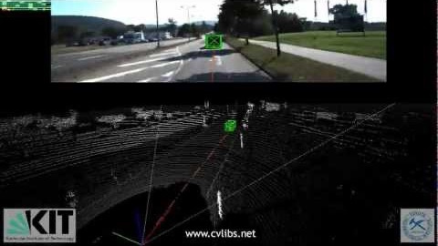
The KITTI Vision Benchmark Suite

Slide 19
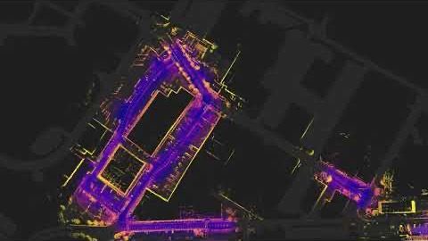
nuScenes Dataset

Slide 20

Additional Exercise
Create an object detector of AGH logo
Python 3 as a preferred language
No restrictions on libraries used
We also understand C/C++, MATLAB & R
Worth 7 points
Deadline: the end of the semester

